Slide 1
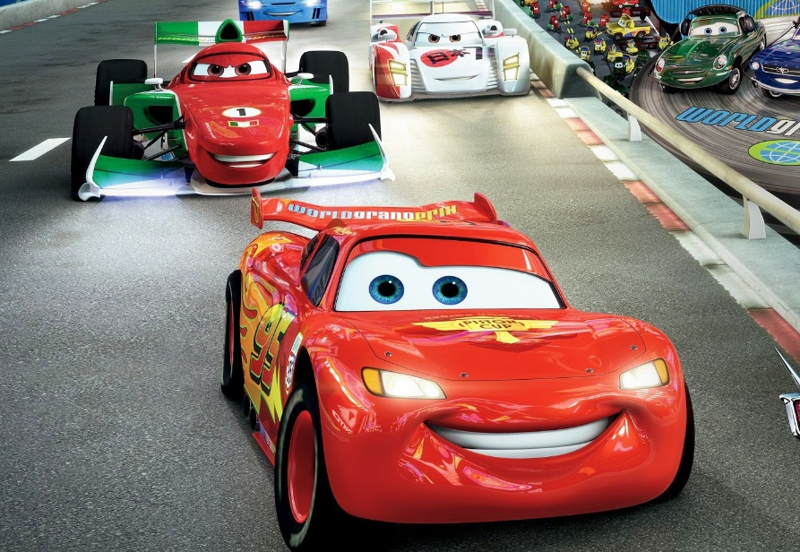
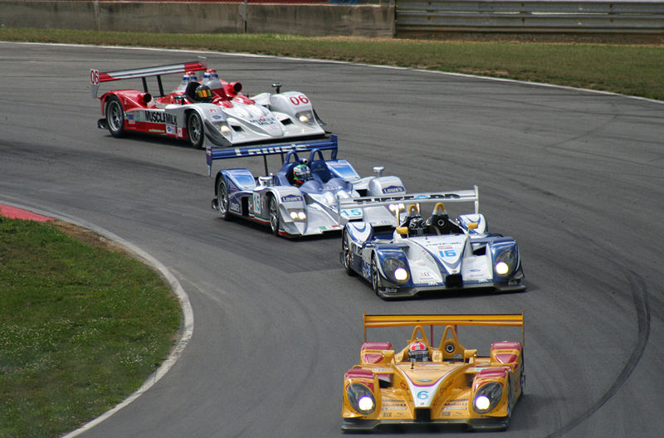

Slide 3
Hiteon’s Biggest Fundraiser
$45,000
GOAL
Supports:
Classrooms
Art Lit
Bingo Night
Family Dance
Technology
Science Fair
Class Parties!

Slide 4
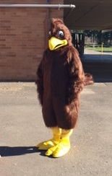
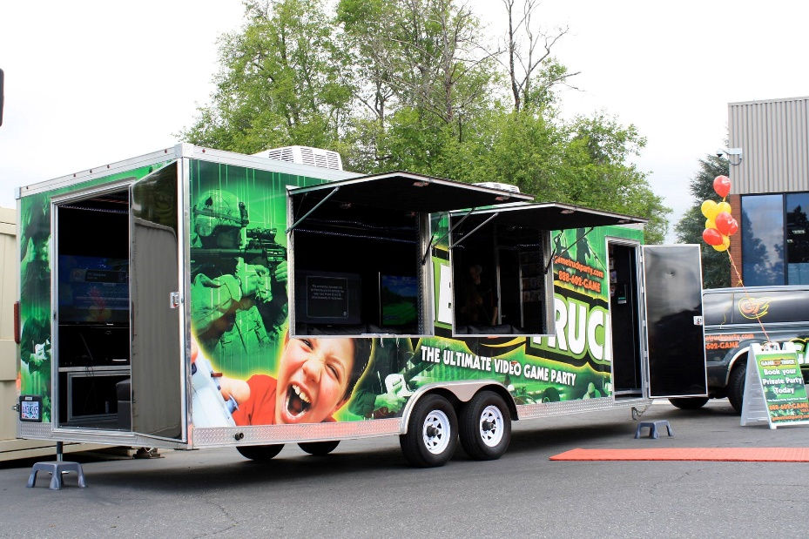
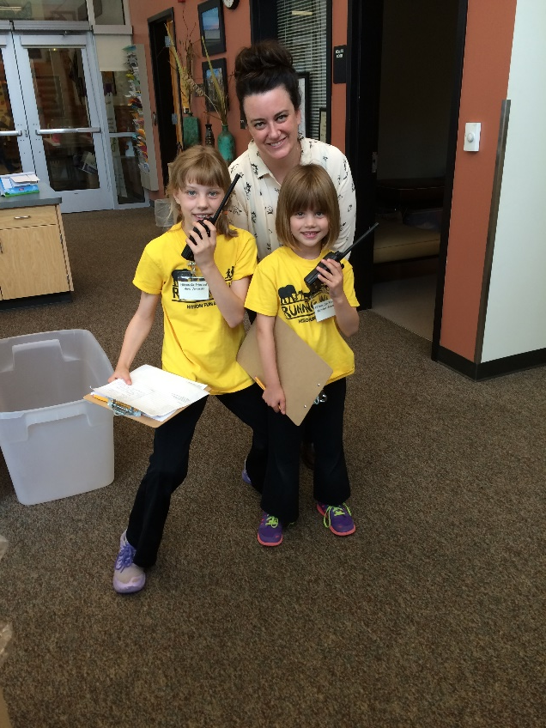
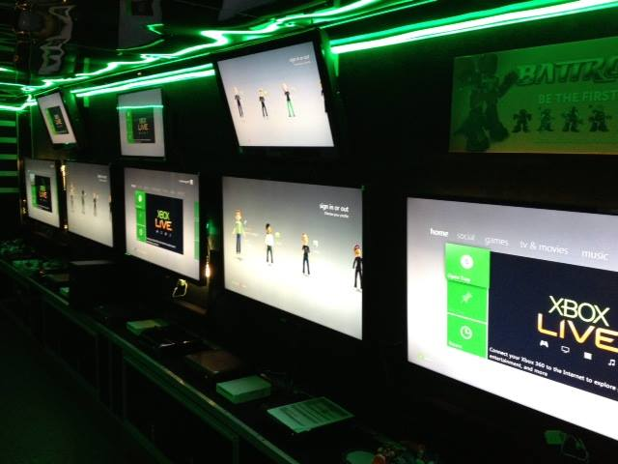
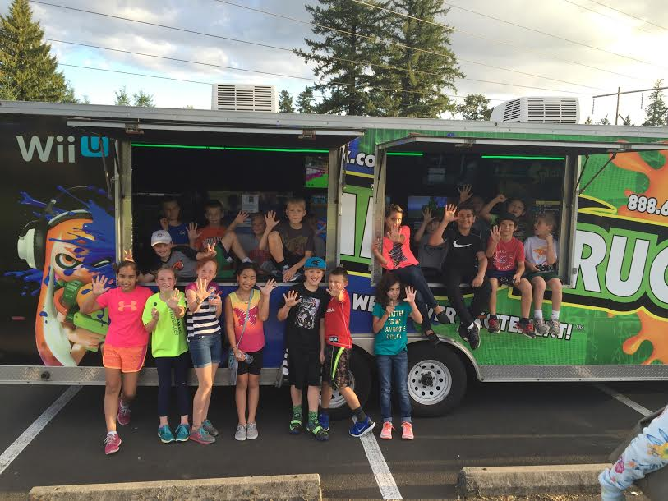
Top fundraiser in the school
Receives a picture with
the Hiteon Hawk
Gets a gift certificate for a free Gametruck party ($379 value)
Will be Principal for
a day (lunch included)

Slide 5
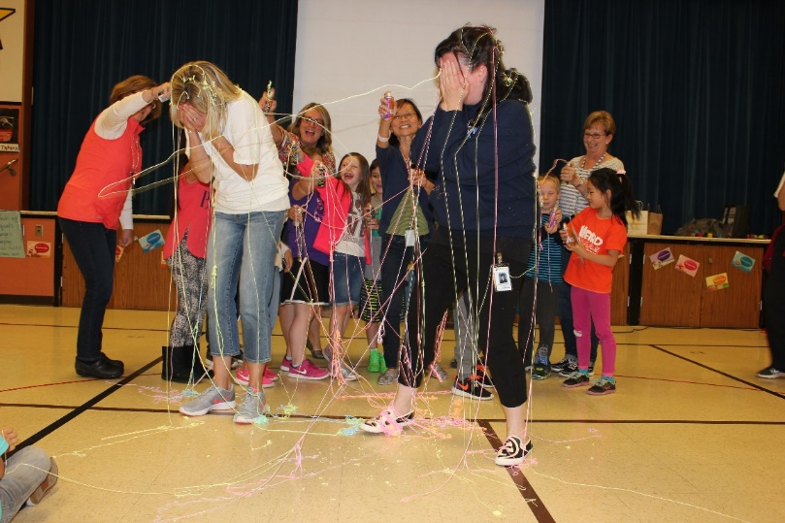
Top fundraiser in each grade
Gets to Silly String the principles (if we reach our $45,000 fundraising goal)
Gets their picture taken with the Hiteon Hawk
Has their name drawn to win one of these awesome prizes of $50 value:
1 - Bowling party at Sunset Lane
2 - Pump It Up: 10 open jump passe
3 - Big Al’s Bowling gift card
4 - John’s Incredible Pizza gift card 5 - Sky High Sports gift card
6 - Cinetopia Movie gift card

Slide 6
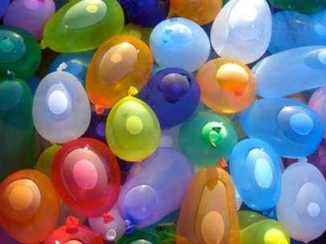
Top runner in each class/grade
Receives a certificate of honor (boy & girl from each class)
photo with the Hiteon Hawk
Will participate in the Water Balloon Toss on Field Day

Slide 7
Top 2 money raising classrooms receive a GameTruck Party

Slide 8
Top 3, 4 & 5 money raising classrooms receive an ice cream party!

Slide 9
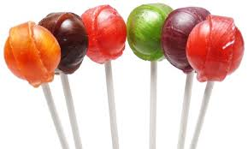
All students who return their envelope packet on or before Fun Run Day will receive a lollipop.
All participants in the Fun Run will receive an Otter Pop at the end of their run.

Slide 10
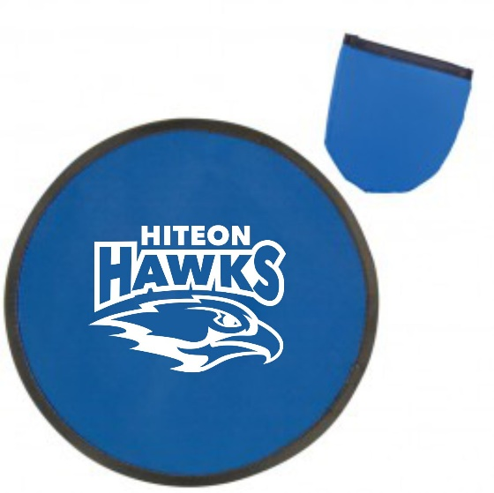
All fundraisers who collect $25 or more in donations will receive a blue folding frisbee with the Hiteon Hawk Logo.
All fundraisers who collect $50 or more in donations will receive the Frisbee AND a Space Pen.
Prizes

Slide 11
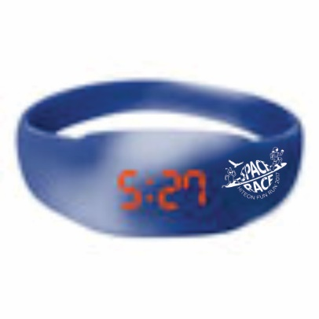
All fundraisers who collect $100 or more in donations will receive the frisbee, space pen AND a Mood Watch with the Hiteon Hawk logo.

Slide 12
Go Hawks!!!

